Slide 1
Try This, Catch That, Finally
CODE1865US
An Explanation on PowerCLI Error Handling
Justin Sider (He/Him)
Chief Information Officer – Belay Technologies
#vmwareexplore #CODE1865US

Slide 2
Required Disclaimer
This presentation may contain product features or functionality that are currently under development.
This overview of new technology represents no commitment from VMware to deliver these features in any generally available product.
Features are subject to change, and must not be included in contracts, purchase orders, or sales agreements of any kind.
Technical feasibility and market demand will affect final delivery.
Pricing and packaging for any new features/functionality/technology discussed or presented, have not been determined.

Slide 3
Who am I?
Terminating Errors
Non-Terminating Errors
ErrorAction thingys
Try & Catch
Finally
PowerCLI Demo
API Demo
https://github.com/jpsider/Invoke-Automation/tree/master/Powercli/VMworld2022

Slide 4

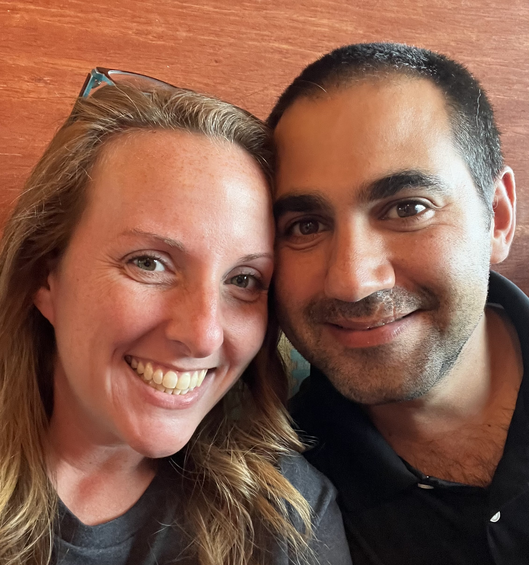
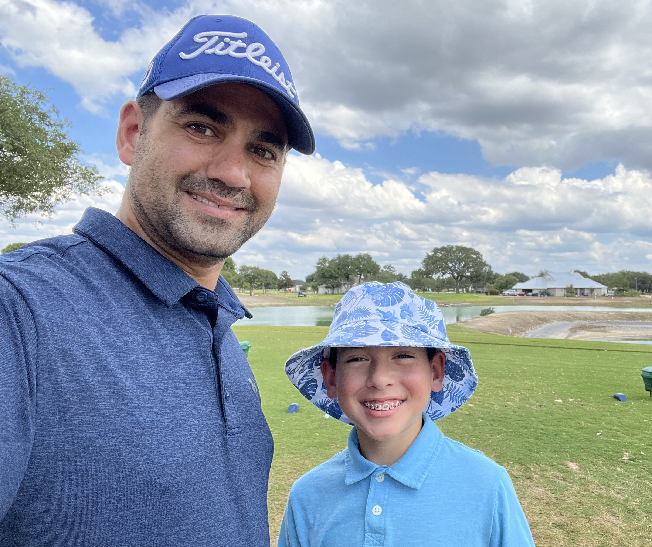
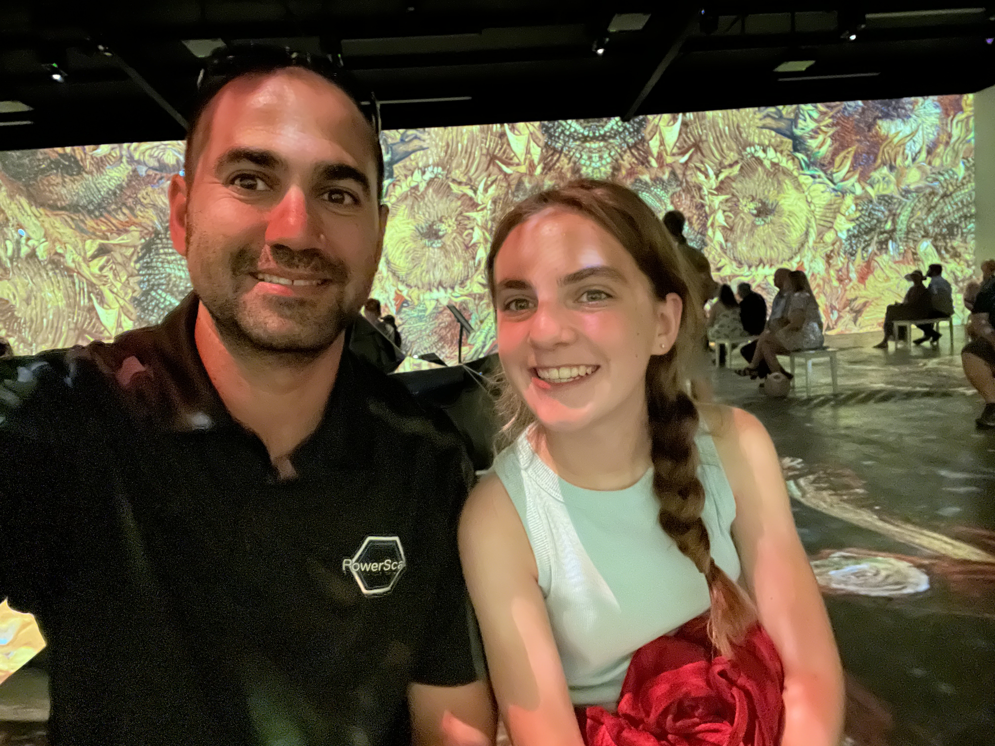
Justin P. Sider
Job
CIO – Belay Technologies
Blog
https://invoke-automation.blog
GitHub
https://github.com/jpsider
Twitter/Slack
@jpsider
VMware Programs
VMUG Advantage
vExpert x7
VMware Code Coach 20-22

Slide 5
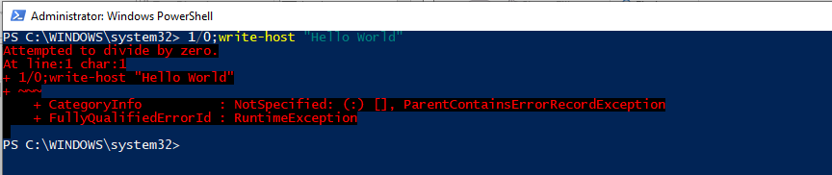
Terminating Errors
It stops or halts the execution of the script so that the commands in the next lines cannot be executed.
https://github.com/jpsider/Invoke-Automation/tree/master/Powercli/VMworld2022

Slide 6
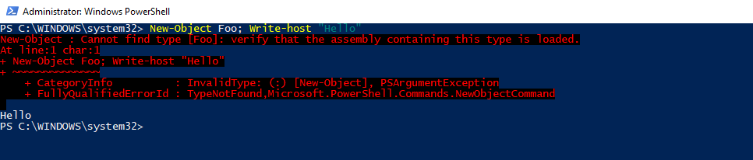
Non-Terminating Errors
Are generally generated by internal cmdlets and automatically handled by them, but the error does not terminate the execution of the pipeline.
https://github.com/jpsider/Invoke-Automation/tree/master/Powercli/VMworld2022

Slide 7
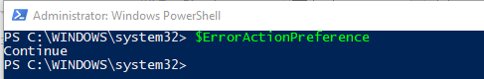
ErrorAction Thingys
$ErrorActionPreference
Only responds to Non-terminating Errors
Console/Script Specific
-ErrorAction Parameter
Specific to a command
Overrides $ErrorActionPreference
Options
SilentlyContinue, Stop, Continue, Inquire, Ignore, Suspend, Break
https://github.com/jpsider/Invoke-Automation/tree/master/Powercli/VMworld2022

Slide 8
Try & Catch
Try {
Run a command
}
Catch {
Capture the problem. Maybe log about it. But it allows you to continue.
}
Note: Catch is REQUIRED with a Try.
https://github.com/jpsider/Invoke-Automation/tree/master/Powercli/VMworld2022

Slide 9
Finally (Optional)
Try {
Run a command
}
Catch {
If there is an issue.
}
Finally {
Will run, no matter what!
}
https://github.com/jpsider/Invoke-Automation/tree/master/Powercli/VMworld2022

Slide 10

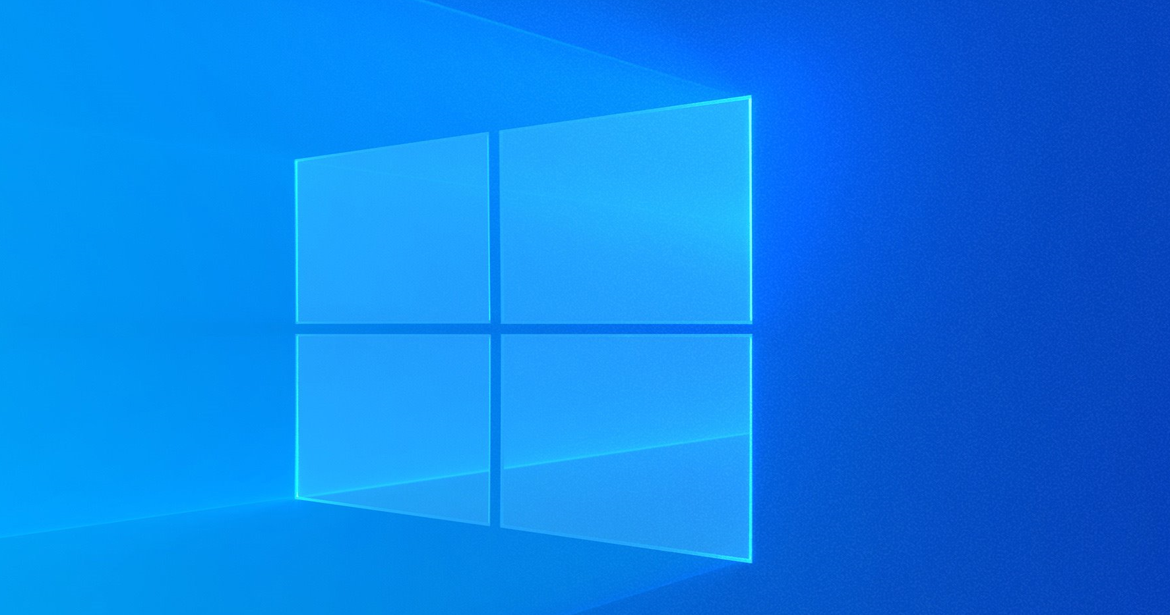

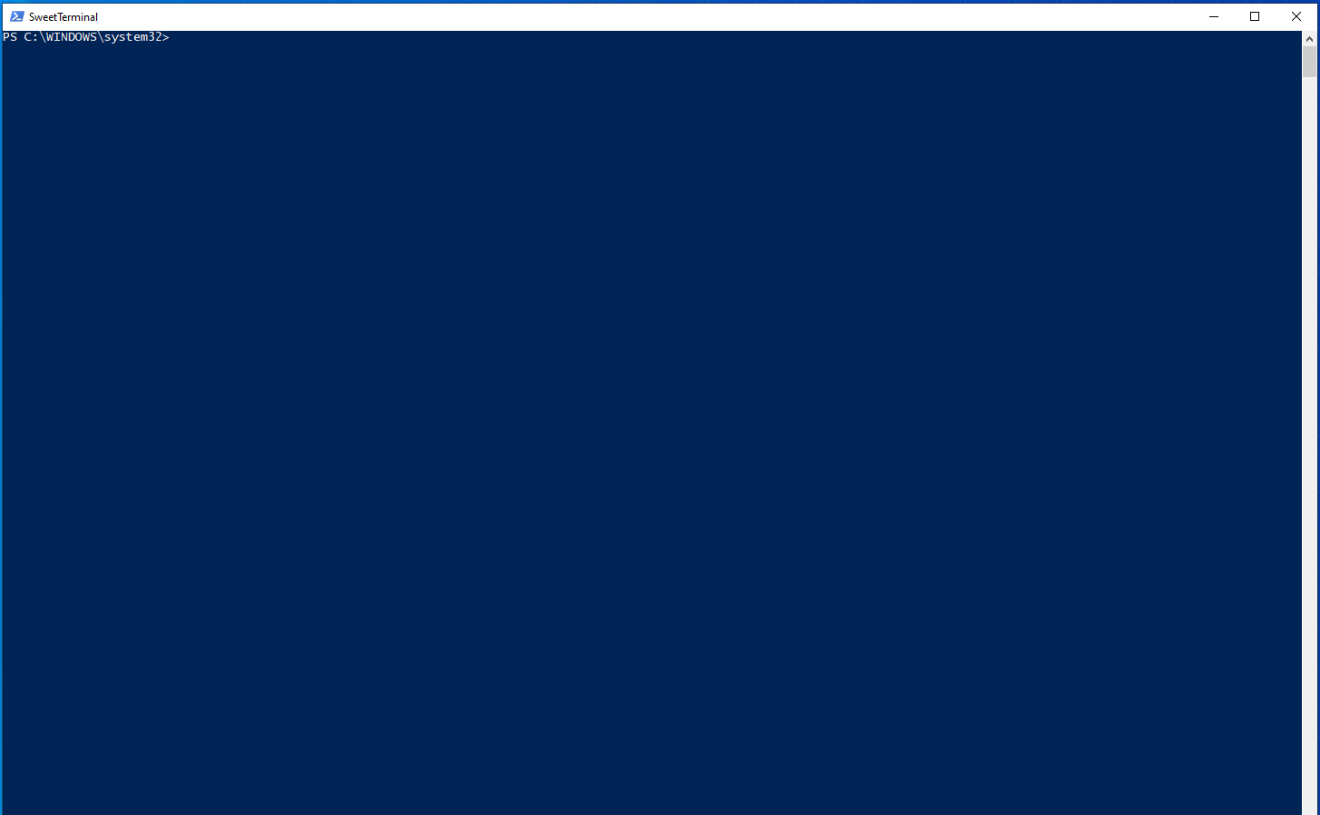

Quote Slide: Leaf and Ocean Color Theme
https://github.com/jpsider/Invoke-Automation/tree/master/Powercli/VMworld2022
Demo time!
PowerCLI

Slide 11

Quote Slide: Leaf and Ocean Color Theme
https://github.com/jpsider/Invoke-Automation/tree/master/Powercli/VMworld2022
Demo time!
API’s

Slide 12
Big statement text only; in Leaf color theme
Recap –
You’ve Got This!
https://github.com/jpsider/Invoke-Automation/tree/master/Powercli/VMworld2022

Slide 13
Please take your survey.

Slide 14
Thank You

